Slide 1
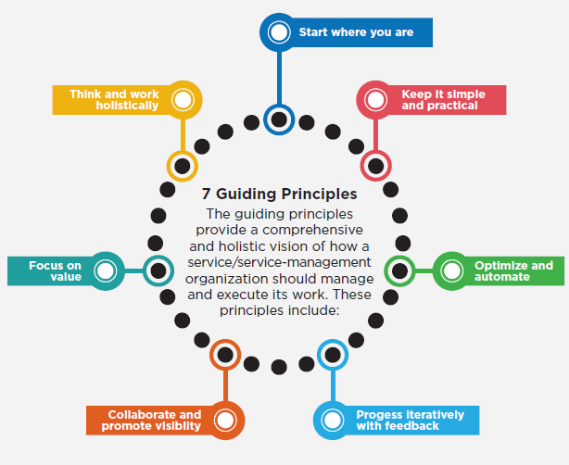
ITIL4 Guiding Principles

Slide 2
ITIL4 Guiding Principles
FOCUS ON VALUE
Everything that the organization does needs to map, directly or indirectly, to value for the stakeholders. The focus on value principle encompasses many perspectives, including the experience of customers and users.

Slide 3
ITIL4 Guiding Principles
START WHERE YOU ARE
Do not start from scratch and build something new without considering what is already available to be leveraged. There is likely to be a great deal in the current services, processes, programs, projects and people that can be used to create the desired outcome.

Slide 4
ITIL4 Guiding Principles
PROGRESS ITERATIVELY WITH FEEDBACK
Do not attempt to do everything at once. Even huge initiatives must be accomplished iteratively. By organizing work into smaller, manageable sections that can be executed and completed in a timely manner, it is easier to maintain a sharper focus on each effort.

Slide 5
ITIL4 Guiding Principles
COLLABORATE AND PROMOTE VISIBILITY
Working together across boundaries produces results that have greater buy-in, more relevance to objectives and better likelihood of long-term success.

Slide 6
ITIL4 Guiding Principles
THINK AND WORK HOLISTICALLY
The outcomes achieved by the service provider and service consumer will suffer unless the organization works on the service as a whole, not just on its parts.

Slide 7
ITIL4 Guiding Principles
KEEP IT SIMPLE AND PRACTICAL
If a process, service, action or metric provides no value or produces no useful outcome, eliminate it.

Slide 8
ITIL4 Guiding Principles
OPTIMIZE AND AUTOMATE
Resources of all types, particularly human resources (HR) should be used to their best effect. Eliminate anything that is truly wasteful and use technology to achieve whatever it is capable.

Slide 9
Continuous Learning
Continuous learning is your self-motivated persistence in acquiring knowledge and competencies in order to expand your skillset and develop future opportunities.
Seven Benefits of Lifelong Learning
Remain Relevant
Prepare for the unexpected
Boost your profile
Competence leads to confidence
Spark new ideas
Change your perspective
Pay it forward
To live a life without continuous learning is unthinkable.

